Slide 1

Academic recognition in Latvia
Baiba Ramiņa
Academic information centre
director
19.10.2016 Baku
:

Slide 2
Law on Education (1998)
Section 11.¹ Recognition in Latvia of Education Document Certificates Issued by Foreign States
(2) As a result of the expert-examination of the submitted documents, it shall be determined:
1) which education document issued in Latvia, or which academic degree conferred in Latvia, is equivalent to the education document issued abroad, or to the attesting document in regard to the academic degree conferred abroad, or which education document issued in Latvia, or which academic degree conferred in Latvia, may be considered as equivalent to such;
2) what additional conditions must be fulfilled in order that the education document issued abroad, or the certifying document in regard to the academic degree conferred abroad, may be considered as equivalent to an education document issued in Latvia or an academic degree conferred in Latvia if the education document issued or the academic degree conferred abroad does not conform to the requirements of any education document issued in Latvia or to any academic degree conferred in Latvia.
(3) As a result of the expert-examination of documents, the person submitting the application shall be given a notice in regard to which education document issued in Latvia, or which academic degree conferred in Latvia, is equivalent, or may be regarded as equivalent, to the education document issued abroad, or to the academic degree conferred abroad.

Slide 3
Law on Education (1998)
A decision to recognise an education document shall be taken on the basis of a statement issued by the Academic Information Centre, by:
1) in respect of continuation of studies – the institution of higher education in which the holder of the education document wishes to continue the studies. The institution of higher education may carry out an additional expert-examination and set additional requirements;
2) in respect of hiring employees in professions in which the professional activity, or the education required for it, is not governed by laws or in other regulatory enactments, – the employer;
3) in respect of practising professional activity in professions in which the professional activities, or the education required for it, is governed by laws, as well as in other regulatory enactments – the institutions determined in such laws and other regulatory enactments;
4) in respect of continuation of basic or secondary educational level – the Ministry of Education and Science.

Slide 4
Law on Higher Education Institutions 1995
Section 85. Academic Recognition in Latvia of Academic Degrees and Education Documents Acquired in Other Countries
(2) During an expert-examination of submitted documents, the following shall be determined:
1) whether the education document acquired in another country conforms with any higher education document awarded in Latvia (hereinafter in this Section – diploma);
2) to which academic degree or diploma awarded in Latvia it may be equated; and
3) what additional provisions shall be met so that the education document obtained in another country could be equated to any academic degrees or diplomas awarded in Latvia, if the academic degree or education document obtained in another country does not meet the requirements of any academic degree or diploma awarded in Latvia.

Slide 5
Law on Higher Education Institutions 1995
If education is continued in Latvia, the relevant institution of higher education shall take a decision, on the basis of the statement of the Academic Information Centre, regarding the recognition of the academic degree or education document obtained in another country for the continuation of studies.

Slide 6
Law on Higher Education Institutions 1995
Section 84. Recognition of Part of the Higher Education Acquired in Other Countries
Recognition of part of the higher education acquired in other countries shall be performed by that institution of higher education in which the student continues his or her education. The institution of higher education shall determine:
1) to which study programme the part of higher education acquired in other countries corresponds;
2) in what way the student may continue his or her studies in the relevant study programme; and
3) if necessary – what additional requirements shall be met in order to continue studies in the relevant study programme in Latvia.

Slide 7
CoM Regulations No 142 «Procedure of referencing degrees and professional qualifications» (28.02.2012)
Stipulate procedure how degrees and professional qualifications (higher education level), which have been obtained in Latvia after graduating from a study programme, which implementation had been started before December 26, 2000 (when present degree and professional qualification regulations came in force) are referenced to the degrees and professional qualifications stated in the Law on Higher Education Institutions (1995)
Refer to the degrees and professional qualifications issued both during the Soviet times and in the independent Latvia during 1990ties

Slide 8
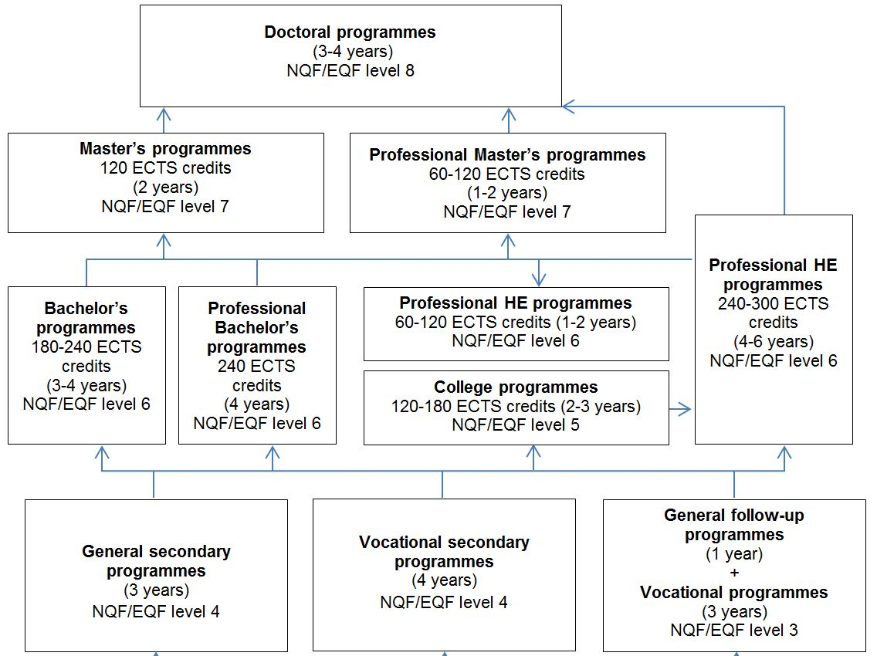
Latvian HE and access qualifications

Slide 9
The placement of the formal qualifications in the LQF/EQF
Level 4-8
Latvian education documents (qualifications) | Level
Certificate of general secondary education, Diploma of vocational secondary education, | 4
Diploma of first level professional higher education (1st level professional higher (college) education. The length of full-time studies 2-3 years) | 5
Bachelor’s diploma Professional Bachelor’s diploma Diploma of professional higher education, diploma of higher professional qualification (2nd level professional higher education, the length of full-time studies – at least 4 years) | 6
Master’s diploma Professional Master’s diploma Diploma of professional higher education, diploma of higher education, diploma of higher professional qualification (2nd level professional higher education, the total length of full-time studies – at least 5 years) | 7
Doctor’s diploma | 8

Slide 10
Credit system
Latvian credit point is defined as a one-week full-time study workload corresponding to 40 academic hours workload.
An average workload of a full-time study year in most HE programmes is 40 credit points. (Law on HEI, 1995)

Slide 11
Link with ECTS
Part of HEIs has already using also ECTS (e.g. Diploma Supplement) as law does not forbid it.
Latvian credit point system is compatible with ECTS. The number of ECTS credits is found by multiplying the number of Latvian credit points by a factor of 1.5.

Slide 12
Learning Outcomes
Since 2011, learning outcomes have become a compulsory part of the higher education study programmes.
However, already since 2004 higher education sector has worked to develop learning outcomes based Bologna cycle descriptors that were integrated in the LQF descriptors approved by the Cabinet of Ministers in October 2010.
HEIs have to formulate learning outcomes for study programmes and courses regarding the requirements set by state education standards and occupational standards (for professional higher education programmes).

Slide 13
The cycle descriptors for LQF level 5 (I)
Characteristics | The competences conforming with the diploma of the 1st level professional higher education (college) comprise the competences of a secondary education graduate and are acquired through professional studies, which proceed in close contact with the relevant professional field
 | In addition to the competences of a secondary school graduate, the holder of the 1st level professional higher education diploma IS ABLE TO:
Knowledge and understanding | demonstrate comprehensive and specialised knowledge and understanding of facts, theories, causalities and technologies of the concrete professional field
Ability to apply knowledge | on the basis of analytical approach, to perform practical tasks in the concrete profession demonstrate skills, allowing to find creative solutions to professional problems
Analysis, synthesis, evaluation | discuss and provide arguments regarding practical issues and solutions in the concrete profession select the necessary information and use it for solving clearly defined problems participate in the development of the concrete professional field demonstrate understanding of the place of the concrete profession in a broader social context
Communication | discuss and provide arguments regarding practical issues and solutions in the concrete profession with colleagues, clients and management

Slide 14
The cycle descriptors for LQF level 5 (II)
General skills | with an appropriate degree of independence, to engage in further learning, improving one’s competences assess and improve one’s own actions and those of other people work in co-operation with others plan and to organise work perform concrete tasks in one’s profession or to supervise such work activities, in which unpredictable changes are possible
Formal aspects (Additional information, not part of the descriptor)
persons, who have acquired secondary education, are enrolled in programmes of 1st level professional higher education persons, who have acquired the qualifications of the 1st level professional higher education are entitled to continue the studies in a relevant study programme for completing a full study cycle the study programmes leading to the acquisition of the 1st level professional higher education comply with the particular occupational standard and comprise 120-180 ECTS credits

Slide 15
EQF vs LQF level 5
 | EQF descriptors | LQF descriptors
K | Comprehensive, specialised, factual and theoretical knowledge within a field of work or study and an awareness of the boundaries of that knowledge | Able to demonstrate comprehensive and specialised knowledge and understanding of facts, theories, causalities and technologies of the concrete professional field
S | A comprehensive range of cognitive and practical skills required to develop creative solutions to abstract problems | Able, on the basis of analytical approach, to perform practical tasks in the concrete profession, demonstrate skills, allowing to find creative solutions to professional problems, to discuss and provide arguments regarding practical issues and solutions in the concrete profession with colleagues, clients and management, able to, with an appropriate degree of independence, to engage in further learning, improving one’s competences Able to assess and improve one’s own actions and those of other people, to work in co-operation with others, to plan and to organise work to perform concrete tasks in one’s profession or to supervise such work activities, in which unpredictable changes are possible
C | Exercise management and supervision in contexts of work or study activities where there is unpredictable change Review and develop performance of self and others | Able to define, describe and analyse practical problems in one’s profession, select the necessary information and use it for solving clearly defined problems, to participate in the development of the concrete professional field, demonstrate understanding of the place of the concrete profession in a broader social context

Slide 16
LQF level 6
 | LQF descriptors
K | Able to demonstrate the basic and specialised knowledge typical of the concrete branch of science or profession and a critical understanding of this knowledge, moreover, a part of this knowledge complies with the highest level of achievement in this branch of science or profession Able to demonstrate understanding of the most important concepts and causalities of the concrete branch of science or professional field
S | Able, by using the mastered theoretical foundations and skills, perform professional, artistic, innovative or research activity, to define and describe analytically information, problems and solutions in one’s own branch of science or profession, to explain them and to provide arguments when discussing these with both specialist and non-specialists Is able to structure independently one’s own learning, to guide one’s own and subordinates’ further learning and improvement of professional qualification, to demonstrate scientific approach to problem solving, to assume responsibility and take initiative when performing individual work, when working in a team or managing the work of other people, to take decisions and find creative solutions under changing or unclear conditions
C | Able to obtain, select and analyse information independently and to use it, to take decisions and solve problems in the concrete branch of science or profession, demonstrate understanding of professional ethics, assess the impact of one’s professional activities on environment and society and participate in the development of the concrete professional field

Slide 17
LQF level 7
 | LQF descriptors
K | Able to demonstrate advanced or extensive knowledge and understanding, a part of which conforms with the most recent findings in the concrete branch of science or professional field and which provide the basis for creative thinking or research, inter alia, working in the interface of various fields
S | Able to use independently theory, methods and problem solving skills to perform research or artistic activities, or highly qualified professional functions Able to provide arguments when explaining or discussing complex or systemic aspects of the concrete branch of science or professional field both to specialists and non-specialists Able to guide independently the improvement of one’s own competences and specialisation, to assume responsibility for the results of staff and group work and analyse them, to perform business activities, innovations in the concrete branch of science or profession, to perform work, research or further learning under complex or unpredictable conditions, if necessary, change them, using new approaches
C | Able to define independently and critically analyse complex scientific and professional problems, substantiate decisions and, if necessary, carry out additional analysis Able to integrate knowledge of various fields, contribute to the creation of new knowledge, research or the development of new professional working methods, demonstrate understanding and ethical responsibility for the possible impact of the scientific results or professional activity on environment and society

Slide 18
LQF level 8
 | LQF descriptors
K | Able to demonstrate that has knowledge of and understands most topical scientific theories and insights, has mastered research methodology and contemporary research methods in the concrete branch of science or professional field and in the interface of various fields
S | Able to assess and select independently appropriate methods for scientific research, has contributed to the expansion of the limits of knowledge or given new understanding of the existing knowledge and its use in practice, by carrying out an original research of major scope, part of which is on the level of internationally cited publications Able to communicate both orally and in writing about one’s own field of scientific activity (one’s own branch) with wider research community and the general public Able to improve one’s scientific qualification independently, by implementing scientific projects, attaining achievements meeting the international criteria of the branch of science, to manage research or development tasks in companies, institutions and organizations, requiring extensive research knowledge and skills
C | Able, by performing independent critical analysis, synthesis and assessment, to solve significant research or innovation tasks, to set independently research idea, to plan, structure and manage large-scale scientific projects, including projects in international context

Slide 19
Criteria for recognition
Status of the education institution
Length or credits of study or education
Rights for further education and work
Previous education
Substantial differences in terms of content, profile, workload, quality and learning outcomes

Slide 20
Case 1
Substantial difference - length of study

Slide 21
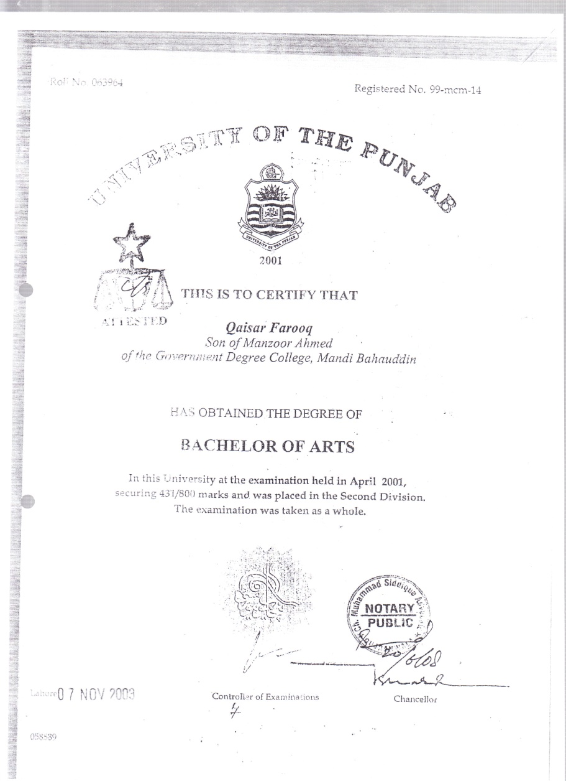

Slide 22
Case 2
What is substantial difference in the content?

Slide 23
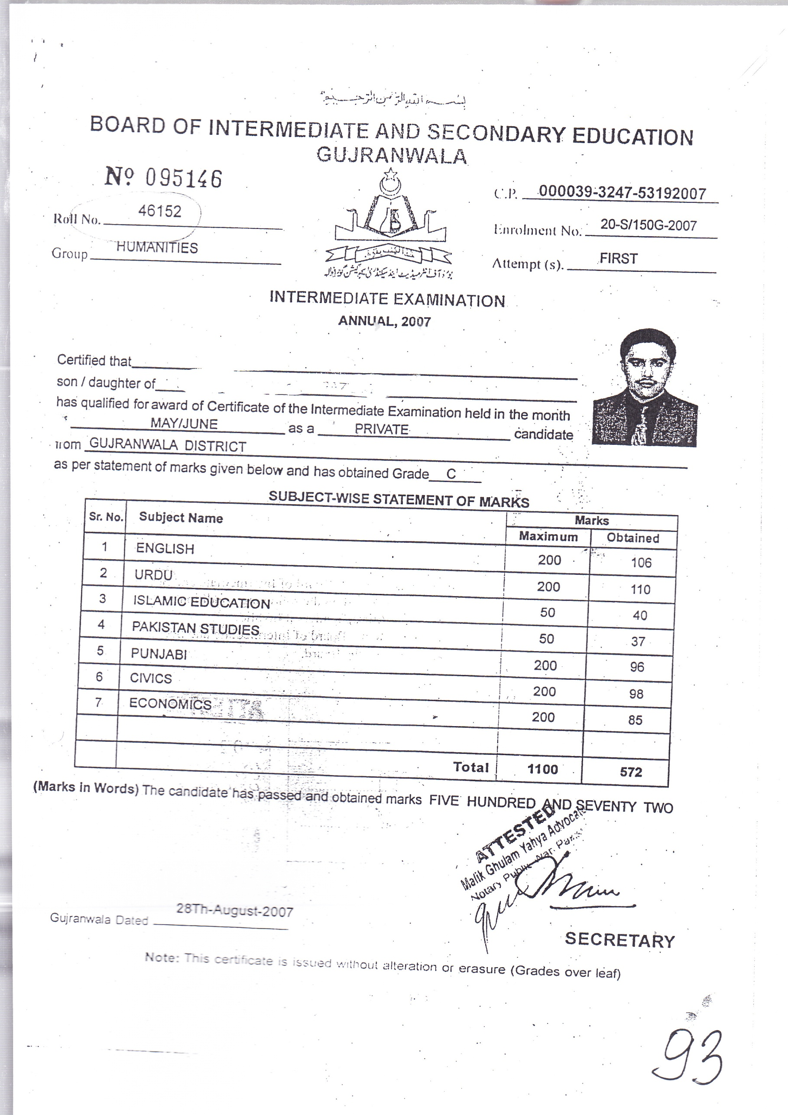

Slide 24
Case 3 Substantial differences
Access requirements

Slide 25
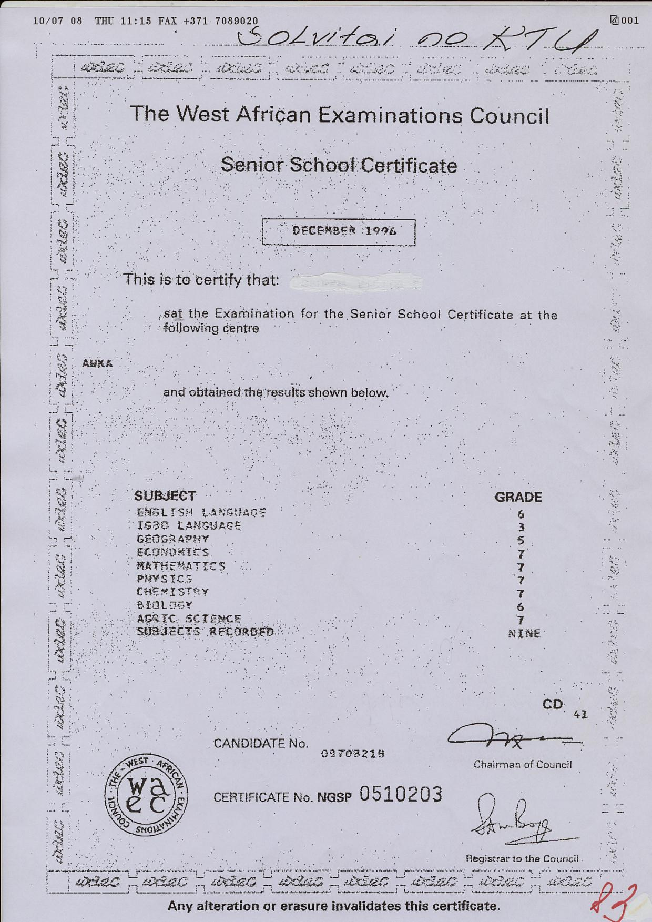

Slide 26
Case 4
Authenticity

Slide 27
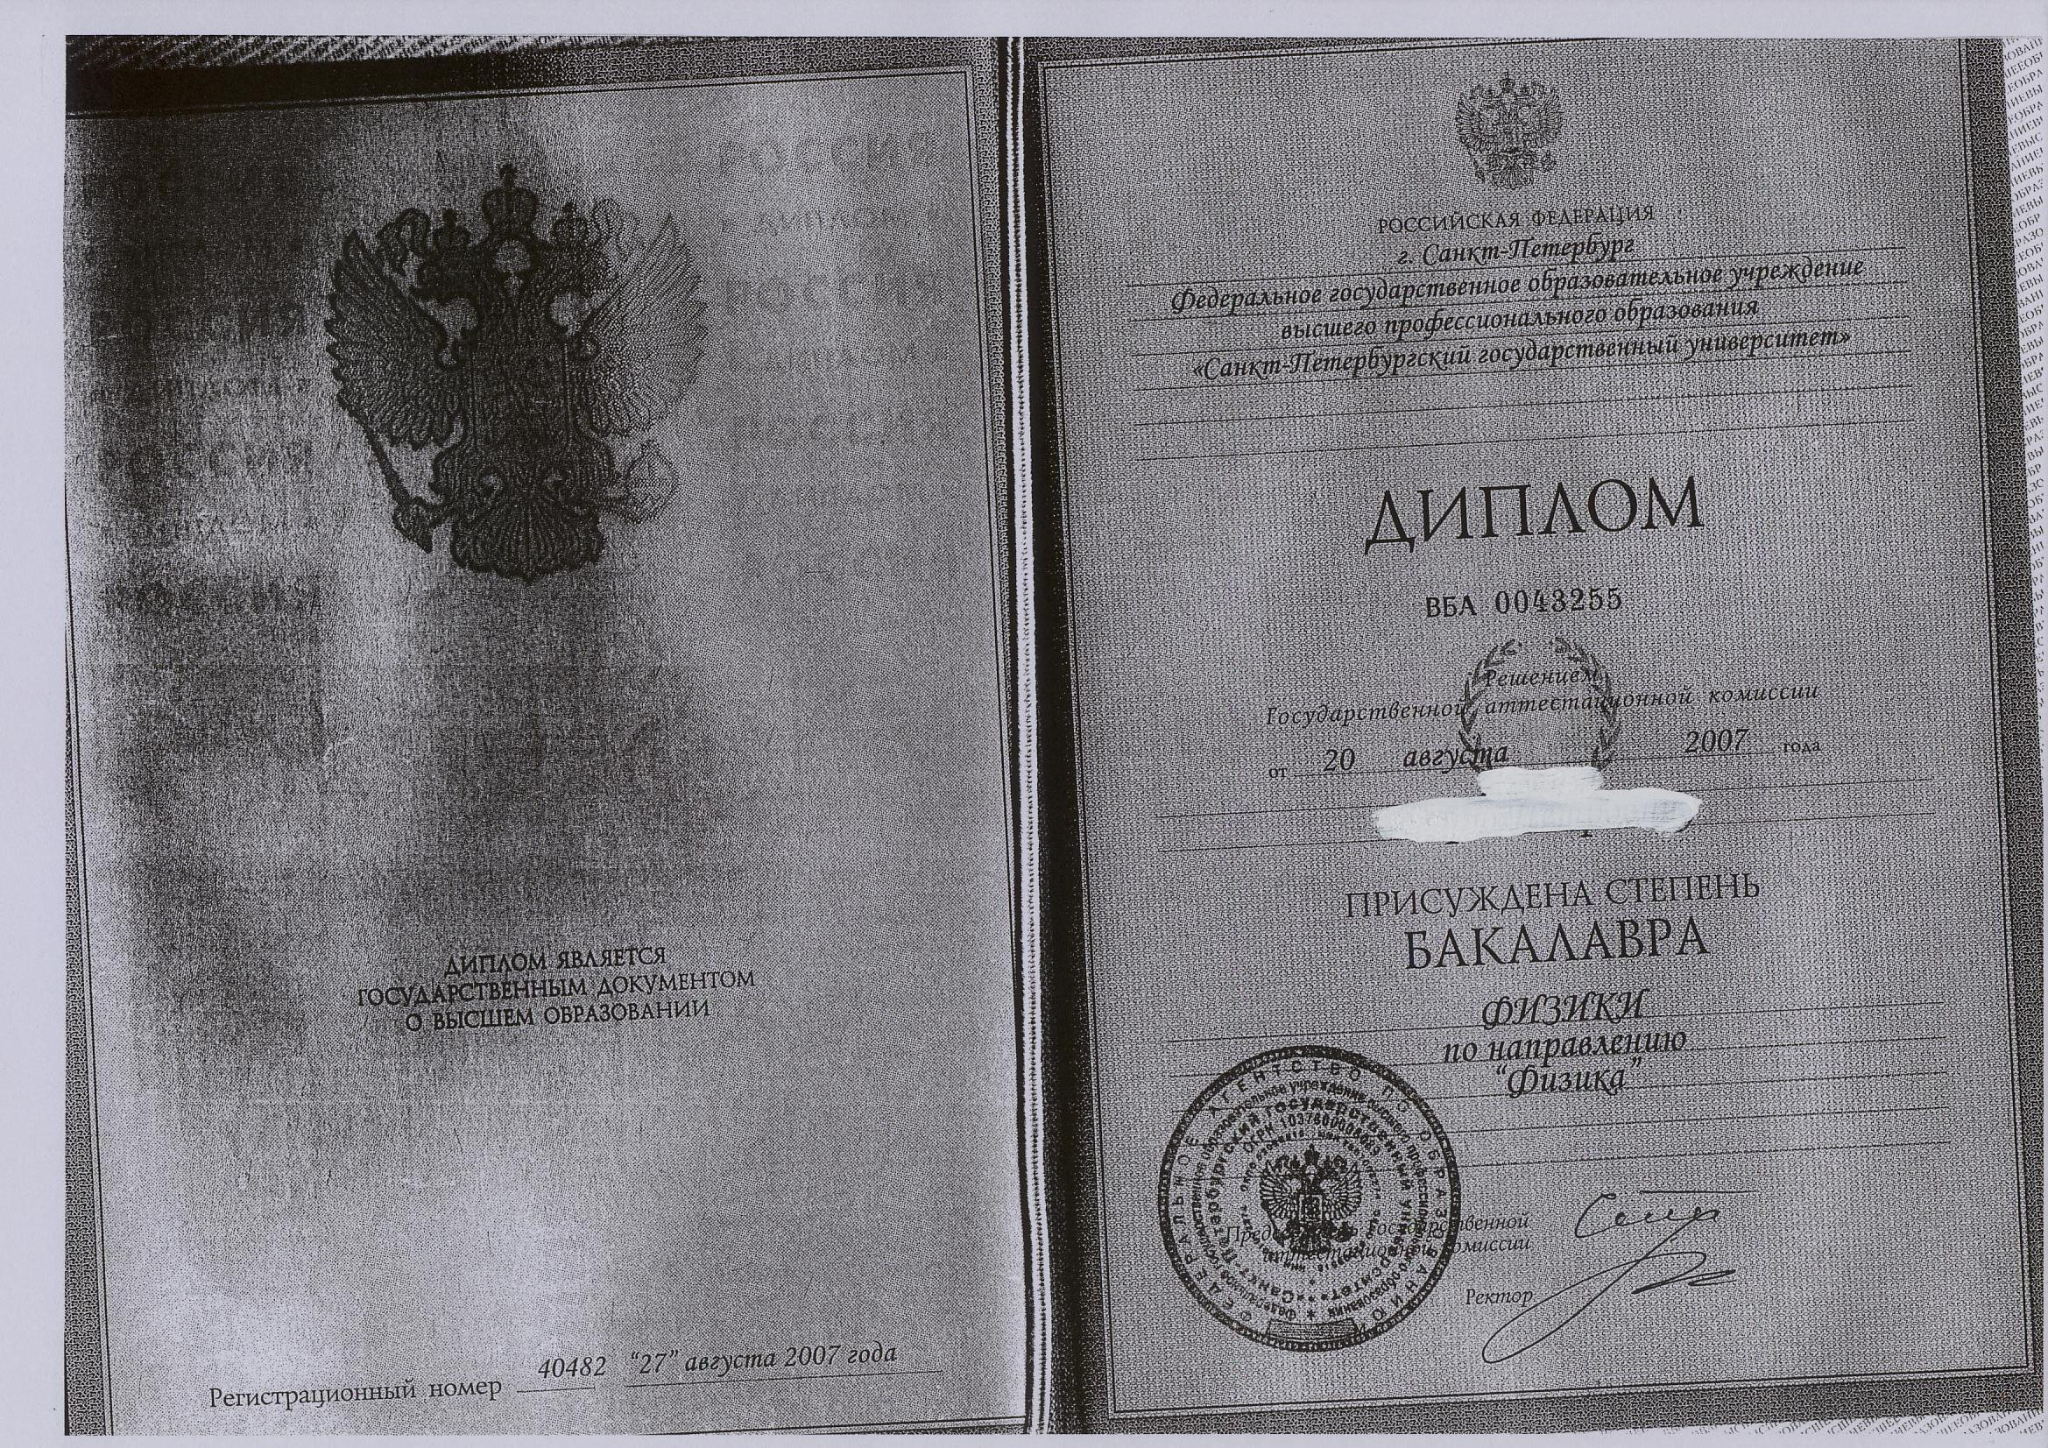

Slide 28
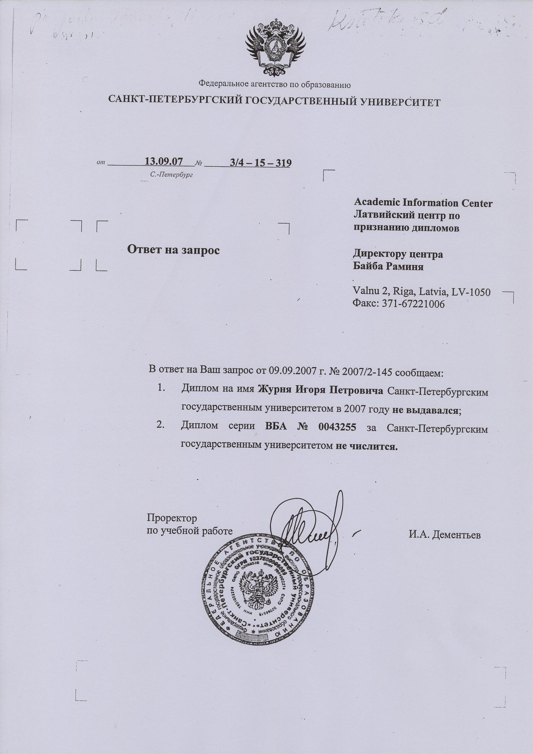

Slide 29
Case 5
Forgeries

Slide 30
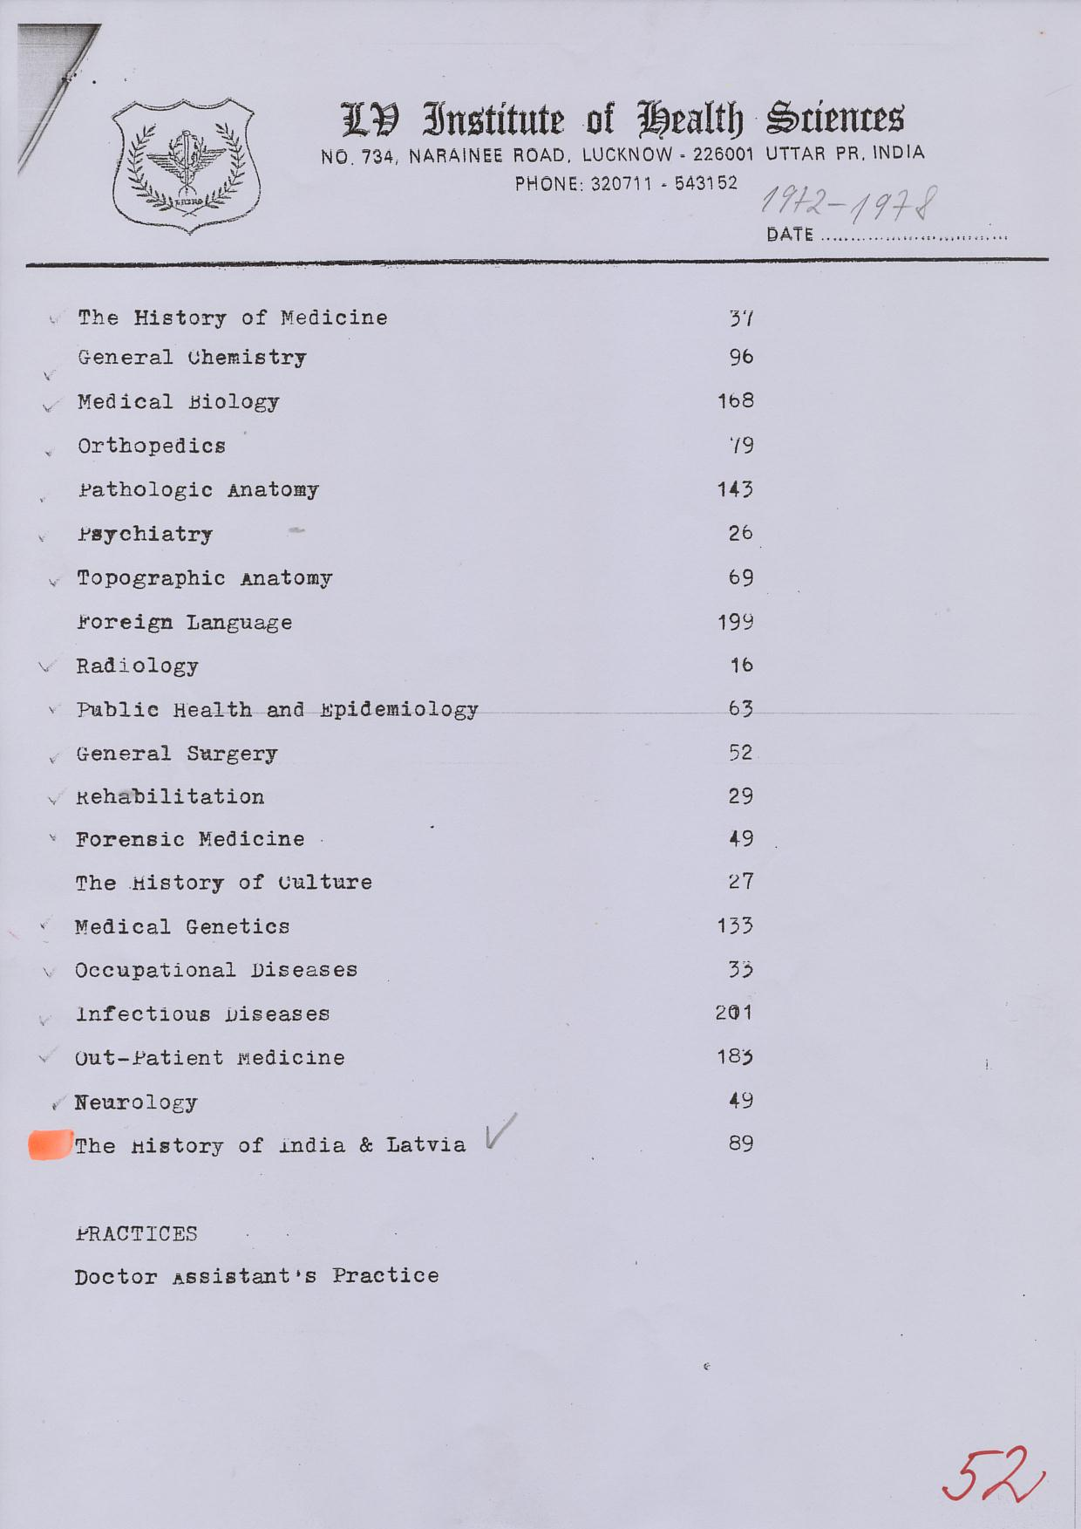

Slide 31
Case 6
Non recognised universities
Diploma mills

Slide 32
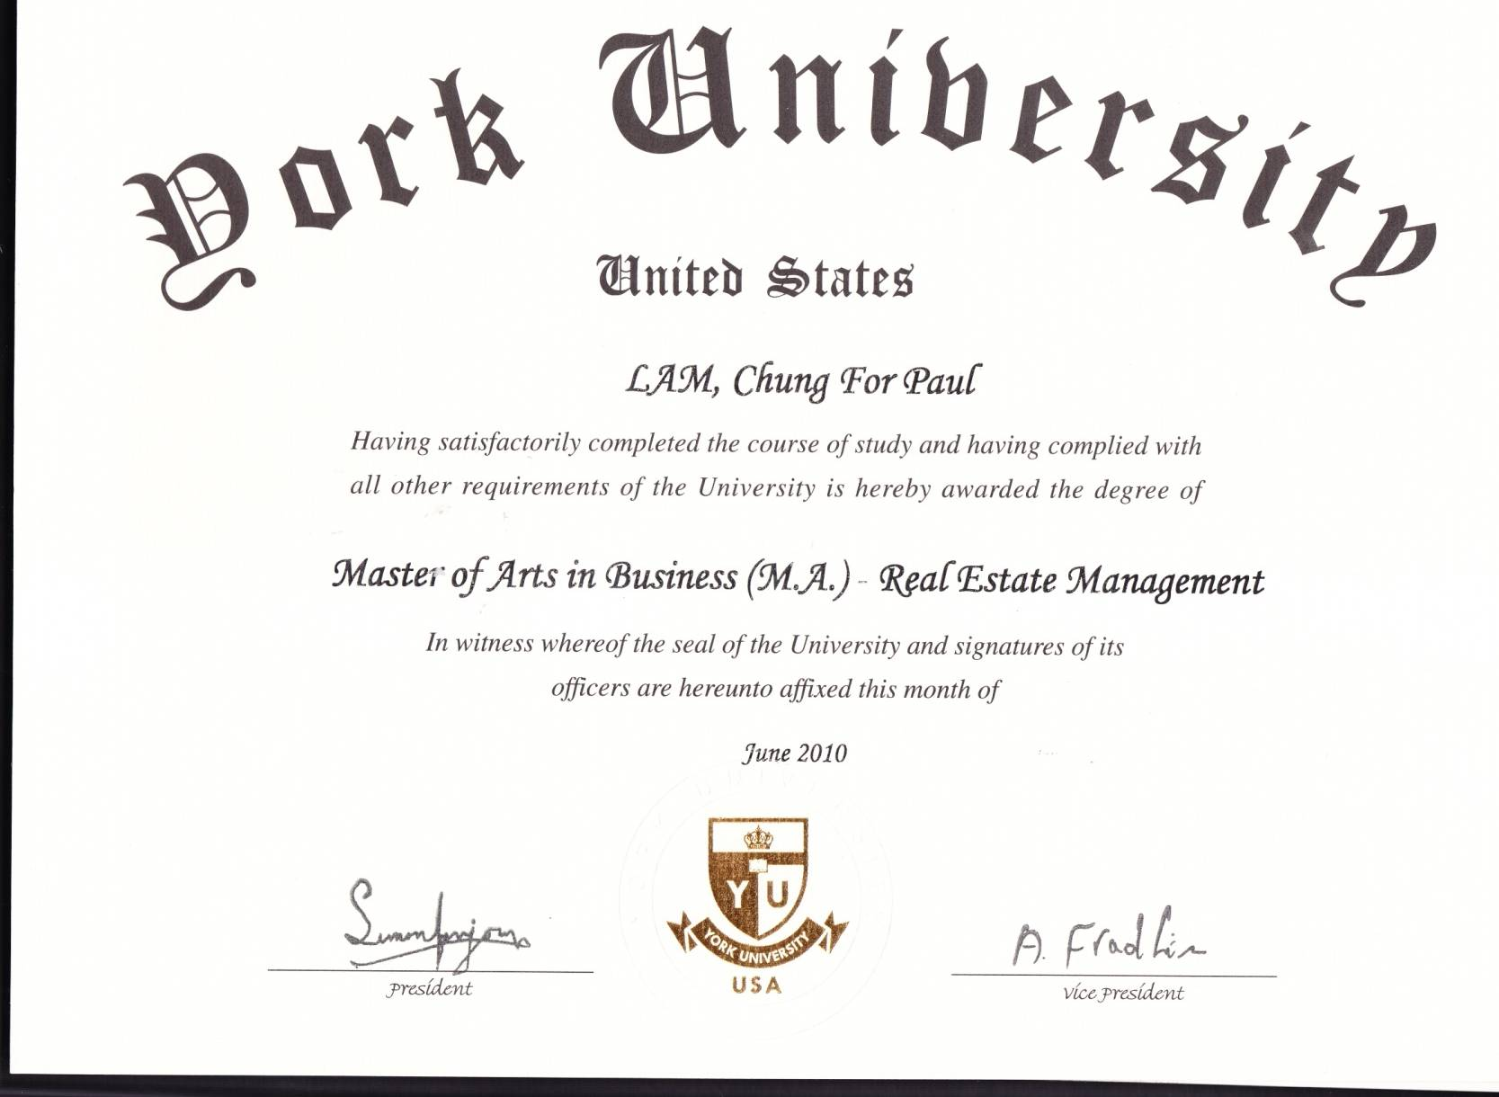
York university

Slide 33
York University, Canada, accredited,
www.yorku.ca
University of York, UK, accredited
www.york.ac.uk
York University , USA, non accredited
www.yorkuniversity.us

Slide 34
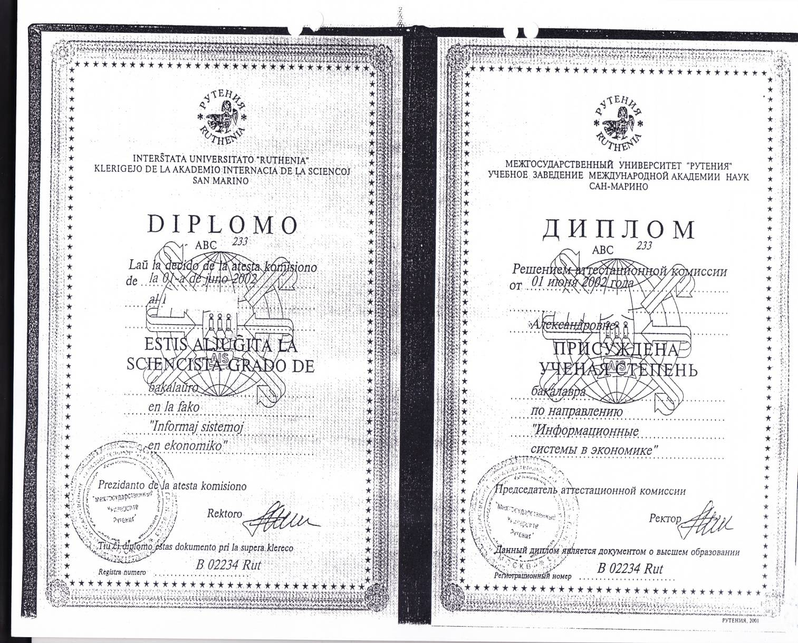
Akadēmiskā atzīšana

Slide 35
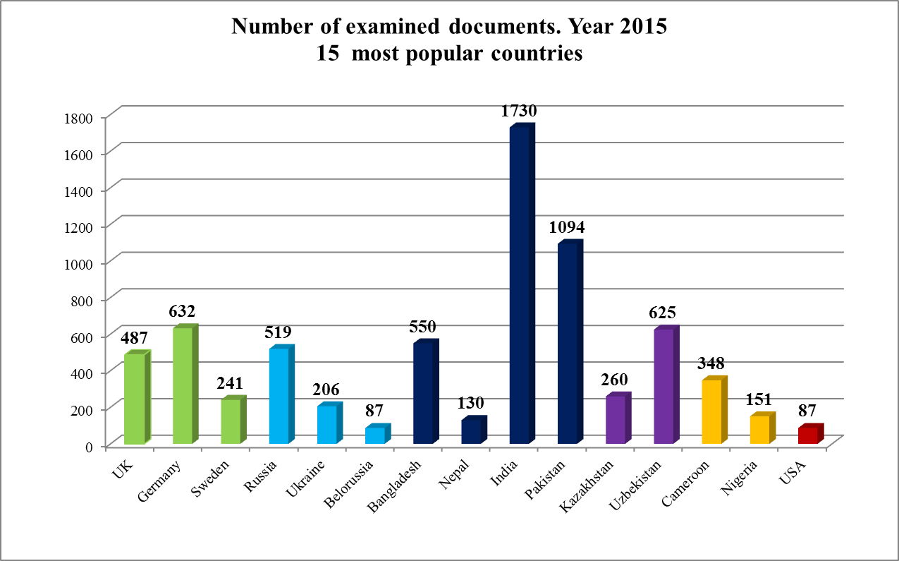

Slide 36
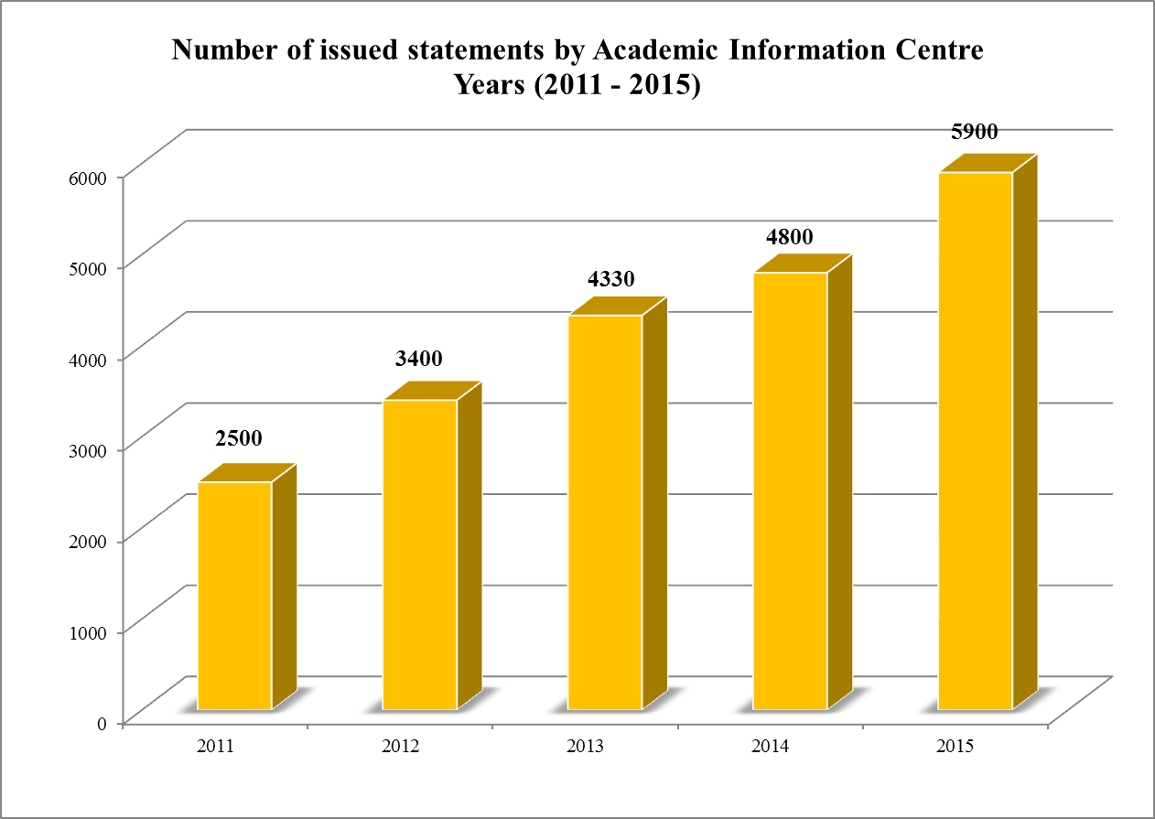

Slide 37
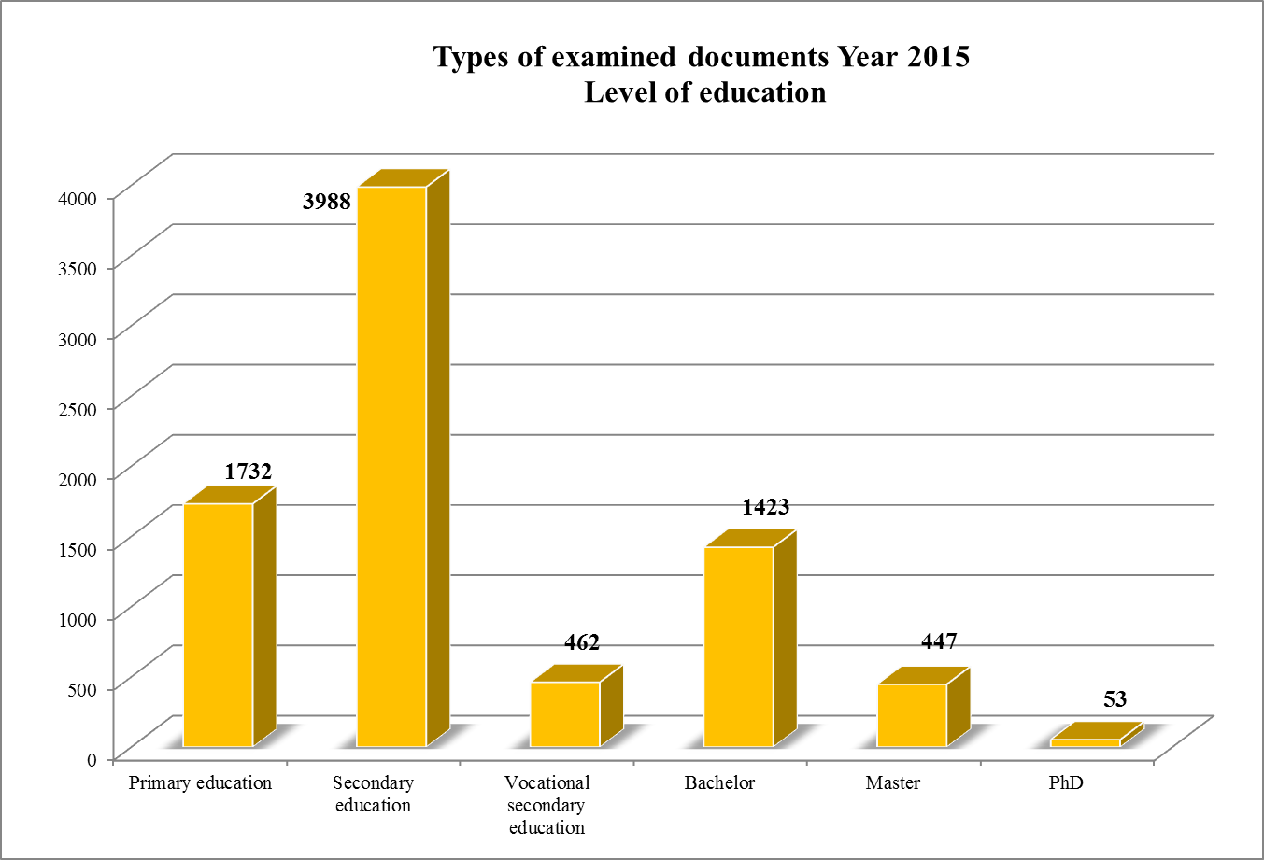

Slide 38
Thank You!

