Slide 1


Enhancing quality of Finnish higher education
Kirsi Hiltunen
15 December 2015
Baku, Azerbaijan

Slide 2
Higher education system in Finland

Slide 3
Quality assurance on the national level
FINNISH EDUCATION EVALUATION CENTRE
Independent agency – in decision-making and operations
Conducts audits of the quality systems of higher education institutions
Carries out thematic evaluations on HE
Develops the evalution of education (processes, methods, participation of differents stakeholder groups etc.)
Supports higher education institutions in issues of quality assurance and quality work
Cooperates actively in international networks on QA (ENQA, NOQA, INQAAHE)
Full member of ENQA
Listed in EQAR 2010 -
MINISTRY OF EDUCATION AND CULTURE
Responsible for steering of HEIs (financial steering and indicators, performance agreements with HEIs, information steering)
Responsible for steering and regulating on distribution of educational responsibilities (fields, degrees and specialisations) based on the proposals of the universities or universities of applied sciences
Responsible for nation-wide student surveys (Bachelor’s level graduates)

Slide 4
QA on the institutional level
HEIs responsible for the quality of their operations
HEIs must evaluate their education, research/RDI and other activities, including societal and regional impact
HEIs required to participate in external evaluations on of their activities and quality assurance systems on a regular basis
HEIs are free to choose the evaluation agency which carries out the external evaluation of the quality system (on a regular basis)
FINEEC operates internationally (audit of the University of Graz in 2013)
The HEIs must publish the findings of the evaluations they undertake

Slide 5
Key features of the HE system (1/2)
Dual system: universities (14) and universities of applied sciences (24)
Core funding from the state but HEIs enjoy wide degree of autonomy from government steering
  The mission of universities is to conduct scientific research and provide undergraduate and graduate education based on it
  The mission of UASs is to train professionals in response to labour market needs and conduct R&D which supports instruction and promotes regional development in particular
  Several reforms and some still going on at both sectors: legal status, number of institutions, organisational structures, funding system etc.
  University and UAS public databases openly available online (an important part of quality assurance)

Slide 6
Key features of the HE system (2/2)
  The right to award degrees/ educational responsibility is determined in legislation (universities) and in operating licences (UASs)
Restricted but equal access; general eligibility for HE is given by the matriculation examination and the upper secondary vocational qualification; entrance tests applied in many fields; access usually results of matriculation exams and entrance tests
Higher education studies are measured in credits; the credit system complies with the European Credit Transfer and Accumulation System (ECTS) – Study courses quantified according to the workload required
  Tuition-fee free system (plan to introduce fees to non-EU/EEA students in 2016)

Slide 7
University degrees
The Government Decree on University Degrees (794/2004) defines the objectives, extent and overall structure of degrees
The universities decide on the detailed contents and structure of the degrees they award; they also decide on their curricula and forms of instruction
Three-cycle system (3+2+4); Bachelor students usually enroll directly to a master’s degree programme
1st cycle degree: Bachelor’s degree, at least 180 ECTS (3 years)
2nd cycle degree: Master’s degree, at least 120 ECTS (2 years)
3rd cycle degree: Doctoral degree (4 years)

Slide 8
UAS degrees
The Government Decree on Polytechnics (352/2003) defines the objectives, extent and overall structure of UAS degrees
MoE confirms the degree programmes, and within the framework of these regulations,
UASs decide on the content and structure of their degrees in more detail; they also decide on their annual curricula and forms of instruction
1st cycle degree = Bachelor’s degree; 180, 210 or 240 ECTS (3-4 years)
2nd cycle degree = Master’s degree; 60 or 90 ECTS (1-1.5 years)
  Eligibility: Relevant first-cycle degree with at least 3 years of relevant work or artistic experience

Slide 9
Finnish Education Evaluation Centre

Slide 10
Independency
Independent in decion-making and operations
Usage of the budget
Project plans for the each evaluation
Apppointment of the evalution teams
Results of the evaluations and publishing of the reports
Recruitment of the personnel
Internal organisation structure of the Centre
Communication and interaction with society and stakeholders
Evaluation Council and Higher Education Evaluation Committee appointed by the MoE, on the basis of nominations by HEIs and other stakeholders
National Plan on Evaluation of Education approved by the MoE, on the basis of the proposal by the Evaluation Council

Slide 11

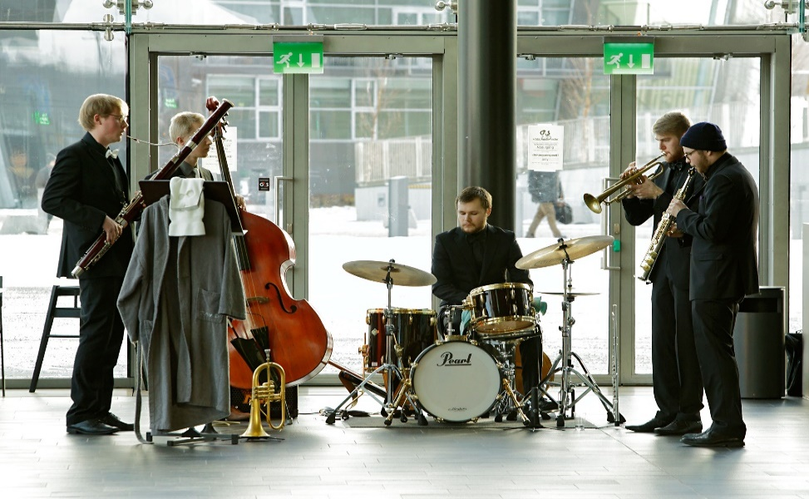
From pre-school to higher education
Pre-Primary and Primary
Upper secondary education
Vocational education and training
Basic education in arts
Liberal adult education
Adult education
Higher education

Slide 12
Evaluations of higher education
Audits of Quality Systems of HEI`s
Universities and Universities of Applied Sciences
Since 2005
Thematic evaluations, for example:
  Study paths and working life co-operation between vocational education and training and professional higher education (ongoing)
  National evaluation on doctoral education
  National evaluation on RDI activities in the UAS sector
Evaluations of educational fields, for example:
Education and training in early childhood education
Voluntary Engineering Programme Accreditations (EUR-ACE)

Slide 13
Higher Education Evaluation Committee
Successor of the Finnish Higher Eduation Evaluation Council (1996-2014)
9 members: HEIs representing both HE sectors, students, working life representative
Desides on Audit manual, audit teams and audit outcomes
Approves the project plans, planning groups and evaluation teams regarding evaluations of higher education

Slide 14
FINEEC audit model

Slide 15
Premises for the audit
Finland’s response to the requirements of the Bologna process to develop a comprehensive national higher education QA system in accordance with the European Standards and Guidelines for Quality Assurance in the European Higher Education Area (ESG)
  The goal of audits is to support HEIs in developing their quality systems to correspond to the European principles
Institutional approach – the same model applied for both higher education sectors (universities and universities of applied sciences)
  Comprehensive approach – covers education, research and societal impact – and overall quality management
Reflects institutions’ autonomy and responsibility, and a large measure of trust
  HEIs are responsible for the quality of their operations
  Each institution develops its quality system based on its own needs and goals

Slide 16
External assessment of internal QA
Audit
Assesses whether the quality system of a HEI is fit for purpose and functioning and whether it complies with the agreed criteria
Focuses on the procedures that the institution uses to maintain and develop the quality of its operations – Does not evaluate, e.g., the mission of the HEI, strategy as such, results, quality of education, quality of research
Some terminology
Quality management: Quality management refers to the procedures, processes or systems that the HEI uses to maintain and develop the quality of its activities.
Quality culture: Among other things, quality culture describes the environment and atmosphere in which the operations are developed, as well as the individual and collective commitment to the quality work. HEIs themselves define in conrete terms what quality culture means in their context of operation. Well-established quality culture is characterised by wide participation, commitment and transparency.

Slide 17
Audit process
Agreement negotiation
Preliminary time frame for the audit
Auditor training
Submission of the audit material:
Self-evaluation
Other material
Briefing and discussion event
Audit visit
(3-4 days)
Audit team’s report and recommen-dation regarding the audit result
Publication of the report
Quality label – valid for 6 years
Concluding seminar at the HEI
Higher Education Evaluation Committee appoints the audit team.
Higher Education Evaluation Committee makes the decision on the result.
If the HEI does not pass the audit, re-audit in 2-3 years
Feedback from the HEI and audit team
Next audit in 6 years
Follow-up seminar 3 years after the audit

Slide 18
Enhancement-led evaluation
”The goal of enhancement-led evaluation is to help HEIs identify the strengths, good practices and areas in need of development in their own operations. The purpose is, thus, to help HEIs achieve their strategic objectives and steer future development activities in order to create a framework for the institutions’ continuous development.” (Audit Manual)
  Aim to support HEIs in the enhancement of quality and establishment of quality culture by (1) producing information to assist HEIs to develop their activities, and by (2) exchanging and disseminating good practices among other HEIs
Institutions are neither rewarded for a positive result nor punished for a negative one – there are no financial incentives or loss of degree-awarding powers
No ranking among institutions is established on the basis of audits

Slide 19
... reflected in the audit model
Participation of various actors, multifaceted evaluation
  In the whole process: planning, implementation, decision-making
  Variety of perspectives taken into account when gathering and providing information
Interaction
  Public events organised at the HEI prior and after the audit visit to discuss the audit process and results
Trust
  Between the party implementing the evaluation and evaluation participant
Impact – providing relevant information and support
  Reflective self-evaluation primarily a tool that HEIs can use to develop its operations
  Site visit an interactive event
  Autonomy and strategic development of HEIs supported by the institutions’ possibility to select some of the targets of the evaluation
  HEIs participate in a follow-up seminar 3 years after the audit

Slide 20
Audit team
Audit team consists of 5-6 members, representing
  The two higher education sectors (universities, UASs)
  Students
  Working life outside the higher education sector
  Experience and knowledge of the optional audit target
Team members mus have experience in the activities of different personnel groups, as well as in the core duties and management of HEIs
The goal is to include a few individuals with prior experience as FINEEC auditors
HEIs may choose either a Finnish or an international team

Slide 21
Audit targets and criteria – What is reviewed and how is it assessed?

Slide 22
…Audit targets regarding the institution’s core duties

Slide 23



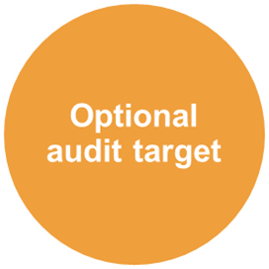
Quality management of the HEI’s core duties, including essential services supporting these (1/3)
The fulfilment of the criteria is reviewed individually for each core duty and optional audit target
Functioning of quality management procedures and their impact on the development of the core duty / optional audit target
Comprehensiveness, usability Roles and involvement of and utilisation of the information produced by the quality system
different parties in terms of quality work, as well as the workload (personnel, students, external stakeholders)
Functioning, workload and effectiveness of the quality management of key support services

Slide 24

Quality management of the HEI’s core duties, including essential services supporting these (2/3)
As an optional audit target, an HEI chooses a function that is central to its strategy or profile and which the institution wants to develop in terms of its quality management
May also be an overarching feature of the institution’s core duties
The optional audit target not taken into account when evaluating whether the audit will pass
Examples of optional audit targets selected by HEIs:
  Undergraduate study guidance, working life integration into teaching, studies preparing for entrepreneurship and the promotion of innovation work and entrepreneurship from the students’ perspective, lifelong learning, internationalisation, staff recruitment, students’ well-being

Slide 25
Quality management of the HEI’s core duties, including essential services supporting these (3/3)
Developing stage:
Functional quality management procedures advance the development of the institution’s core duty / optional audit target and the achievement of goals set for the operations.
The quality system produces relevant information for the development of the core duty / optional audit target, and the information is used for this purpose.
Personnel groups and students are involved in quality work. External stakeholders also participate.
The quality management of key support services functions relatively well.

Slide 26
Samples of degree education (1/3)
Primarily 3 degree programmes chosen as samples of degree education
HEIs choose two of these themselves
  UASs: One programme leading to a bachelor’s degree and one programme leading to a UAS master’s degree
  Universities: One study entity leading to a degree that includes both bachelor’s and master’s education, as well as one programme leading to a doctoral degree
Based on the audit material, the audit team chooses a third degree programme – at the latest, six weeks prior to the audit visit
The fulfilment of the criteria is reviewed individually for each programme – All programmes get individual feedback!
Programmes also complement the evaluation of the quality management of education by providing detailed information at the level of degree programmes

Slide 27
Samples of degree education (2/3)
Planning of the programme
Curricula and their preparation
Intended learning outcomes and their definition
Links between research, development and innovation activities, as well as artistic activities, and education
Lifelong learning
Relevance of degrees to working life.
Implementation of the programme
Teaching methods and learning environments
Methods used to assess learning
Students’ learning and well-being
Teachers’ competence and occupational well-being.
Developing stage:
The quality management procedures related to the planning of educational provision are fully functional and support the planning of the programme.
The quality management procedures related to the implementation of educational provision are fully functional and support the implementation of the programme.

Slide 28
Samples of degree education (3/3)
Participation
Participation of different personnel groups, students and external stakeholders in quality work related to the degree programme.
Effectiveness of quality work
Suitability of key evaluation methods and follow-up indicators and their impact on the achievement of goals.
Developing stage:
Personnel groups and students participate in quality work. External stakeholders also participate.
There is evidence that quality work has an enhancement effect on the programme.

Slide 29
…Policy- and system-level audit targets

Slide 30
Quality policy
Objectives and rationale of the quality system
Division of responsibility related to quality management
Communication of the quality policy
Linking of the quality policy to the institution’s overall strategy
Developing stage:
The quality policy’s rationale, objectives and division of responsibilities are clearly defined and the result of an inclusive process.
The quality policy is accessible to all internal and external stakeholders, taking their information needs into account.
The quality policy is clearly linked to the institution’s overall strategy.

Slide 31
Quality system’s link with strategic management
Information produced by the quality system for strategic management
Functioning of the quality system at different organisational levels and units
Functioning of the division of responsibility and commitment of various parties in the quality work
Developing stage:
The quality system and the information it produces serve strategic and operations management.
Established procedures ensure that the information produced is put to use and communicated systematically within the institution and to external stakeholders.
The system works evenly across different organisational levels and units.
The division of responsibility is effective, and roles and responsibilities in the institution’s quality work are executed with commitment.

Slide 32
Development of the quality system
Procedures for developing the quality system
Development stages of the quality system
Developing stage:
The HEI has in place well-functioning procedures to evaluate and develop the quality system.
The institution is able to identify the system’s strengths and areas in need of development, and development work is systematic.
The development of the quality system after the first audit has been systematic. The system works better than before.

Slide 33
The quality system as a whole
Functioning of the quality management procedures as a coherent system
Comprehensiveness and effectiveness of the quality system
Quality culture of the institution
Developing stage:
The quality management procedures constitute a functioning system.
The quality system covers the essential parts of the core duties of the HEI and provides support for the development of the operations. There is evidence that the system has an impact on the development of the core duties.
The development of the operations is based on an existing quality culture.

Slide 34
Audit targets
1. Quality policy
4. Quality management of the HEI’s core duties, incl. essential services supporting these
5. Samples of degree education (3 degree programmes)
2. Quality system’s link with strategic management
3. Development of the quality system
6. The quality system as a whole
4 b) RDI & artistic activities
4 c) Societal inter-action and regional development work
4 d) Optional audit target
4 a) Degree education

Slide 35
Criteria used in the audit
Audits employ a set of criteria that is based on a scale of four development stages of QA
  absent
  emerging
  developing
  advanced
The development phase for each audit target is determined individually, including each degree programme audited
Threshold for passing: The audit team can propose that the institution passes the audit if none of the targets are ‘absent’ and if the quality system as a whole is at least ‘developing’

Slide 36
Audit target 6. The quality system as a whole

Slide 37

Outcome of audit
The FINEEC Higher Education Evaluation Committee decides on the audit result on the basis of the appraisal by the audit team and on the audit report
The task of the Committee is to ensure that decisions are impartial
HEIs that pass the audit receive a quality label and are added to the register of audited institutions maintained on FINEEC’s website
Appeals procedure
  Can be used by higher education institutions to request a review of the result of an audit or re-audit conducted by FINEEC
  The request may be based on the grounds that the audit process has not been performed in compliance with the audit manual, and that the audit process, as performed, brings into question the fair and equal treatment of higher education institutions.

Slide 38
Discussion
Questions on the presentation?
How many of your universities/programmes have participated in an accreditation? What kind of advice would you give to others, especially on the review process and self-evaluation?
How did you benefit from the accreditation?

Slide 39
Impact of institutional audits

Slide 40
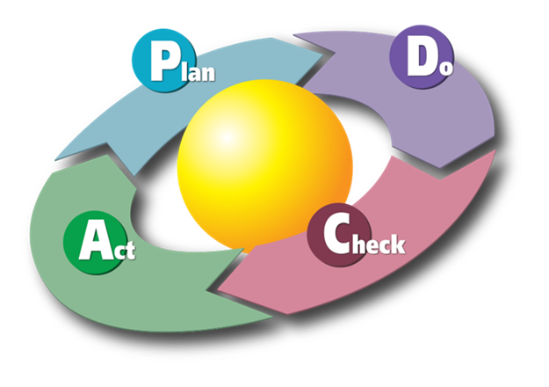
General features of quality systems
Most HEIs use the Deming cycle as the conceptual
framework of quality management
Some HEIs apply widely recognised
quality standards and models
(e.g. the European Foundation for Quality
Management model, or ISO standard), while
others have developed their own quality
assessment methods
Most of the HEIs have hired specific quality personnel – active national networks at both HE sectors
As a rule, the management in HEIs is highly committed to quality work
Students are widely involved in the institutions’ quality work
Specific procedures such as internal audits and joint events to foster quality culture

Slide 41
Quality management of HEIs’ core duties
Quality management of degree education in the best shape
  Various procedures for collecting feedback, links between teaching and research emphasised, external and internal evaluations of degree programmes, procedures to ensure the pedagogical quality of education, tutoring and mentoring systems for new students and staff, alumni systems, personal study plans etc.
  International and doctoral students not as involved as other students
  Quality management of doctoral education a common development area
Quality management of research generally quite well taken care of
  Definition of strategic research profiles, process descriptions, project management guidelines, feedback systems, various internal and external evaluation and rewarding systems
  UASs lack mechanisms to monitor the quality of research
Quality management of societal impact
  A need for clarifying discussion on what is meant by social impact and how it should be measured

Slide 42
HEIs’ views on the impact of audit (1/2)
Improvement of management systems – strengthening of strategic work
Quality management better linked to strategic planning and management as well as operations management
Several UASs report on the link between the quality system and the improved results of their activities (regarding, e.g., dropout rate, progression and completion of studies)
Improvement of feedback systems (student, working life and alumni)
Participation of students and external stakeholders in the development of operations enhanced and supported
More consistent and clarified procedures
Operations planned and developed on a more long-term basis and more extensively from the premises of students and external stakeholders

Slide 43
HEIs’ views on the impact of audit (2/2)
Dissemination of good practices within and between HEIs
More cooperation within institutions between different units and between HEIs
Benchmarking activities have increased
The establishment and development of quality culture enhanced by improving and systematising communication within institutions and to external stakeholders
New evaluation cultures – external evaluations now seen as more significant tools in the development (international evaluations utilised at different organisational levels)

Slide 44
What have we learned during the past 10 years?
– Challenges and strengths

Slide 45
Self-evaluation of our own activities
Strengths:
No ranking – mutual trust, development-orientation
Comprehensiveness – development of the whole institution
Same criteria for both HE sectors + all audit teams have representatives from both HE sectors – deeper understanding and cooperation between the sectors
Audit process itself has impact
Wide participation of external stakeholders
Importance of HE management made more visible – support HEIs in meeting current challenges in higher education (structural reform, profiling of institutions etc.)
Weaknesses:
Emphasis on the (quality) system level
Not much feedback for individual units within HEIs
Threats:
Institutional approach in the second audit round, too > no added value? > frustration? > no commitment or every institution will pass the audit? BUT these threats have not been realised, quite the opposite!

Slide 46
External evaluation by ENQA
Commendable features:
Professional and committed work of the personnel
High quality of audit reports
Open dialogue in feedback to and from institutions
Readiness to carry out self-critical analysis
Clear that our activities contribute to the development of Finnish HE and has the full support of the sector
Excellent working relationship with its stakeholders
Recommendations:
Explicit reference to the standards and guidelines of ESG Part 1 within the Audit Manual, the audit process and the audit reports – Taken into consideration in the new version of the Manual
Continuing attention to the question of international expert participation in its processes and the establishment of the proposed international advisory committee – Appr. half of the second round audits conducted by international audit teams + international advisory board established
To allow for a form of representation to the decidion-making body, subsequent to the audit report, with reference back to the team, in cases where an institution disputed the decision on procedural grounds – Appeals procedure established in 2015

Slide 47
Feedback from stakeholders
FINEEC collects feedback systematically from all audited HEIs and members of audit teams
Systematic analysis and utilisation of feedback (annual development days), for example:
  Summary of the feedback and actions to be taken is published on our webpage annually
  Information was used for the revision of the audit model for the second round (optional audit target to further support institutions’ strategies; more emphasis on programme-level; self-evaluation given more emphasis; clearer guidelines for the compilation of other audit material, too)
  Minor changes and improvements in the criteria and in the evaluation process are done continuously (e.g. auditor training developed constantly, common electronic platform for audit teams)
On the whole, very positive feedback from both HEIs and auditors
  Professionalism of audit teams and FINEEC staff
  Good cooperation between HEIs & FINEEC, and the audit team & FINEEC
  Enhancement-led approach and atmosphere during site visits
  Well-established and ”stable” procedure
  Flexibility – FINEEC audit model enables to create quality systems that are fit for purpose

Slide 48
Lessons learned – Critical success factors
Key organisational issues
  Detailed and well-planned time frame and guidelines for the whole process (self-evaluation report!) well in advance are essential
  If the language to be used to carry out the evaluation no-one’s mother tongue, a lot of translation and spelling out are needed
Team composition and auditor training
  Systematically applied and well-thought selection criteria are required
  International review team: Experts from different HE and QA systems and operational cultures – various challenges in the audit process!
  Auditor training – Enough information on the HE system and audit model as well as plenty of hands-on training and exercises
  Facilitating group dynamics in the early phases of the process is fruitful for the whole process
Site visit
  Should be well-planned and comprehensive
  Should focus on the right and important issues
  Is the key element for the success of the whole process
Fair decision-making regarding the outcome of audit
  Is based on systematic application of the criteria and consistent evaluation procedures,
  High-quality reports
    Ensuring equal treatment of the audited institutions!

Slide 49
Conclusions
Experienced actor in institutional audits: Full cycle of audits conducted during the years 2005-2012; the second audit round going on (until 2018)
  Feedback from the audited Finnish HEIs shows that they have been quite satisfied with the audits
  The model refined four times
  All Finnish HEIs signed up for a FINEEC second round audit
  Added value of international audit teams – new perspectives
The Finnish audit system can be considered a success – audits as enhancement-led evaluations have received wide acceptance
  HEIs and FINEEC mutually trust one another, communication open and supportive
  All Finnish HEIs have established comprehensive quality systems
Trust between HEIs and QA agency is of utmost importance – can be build up gradually and by open and transparent communication and cooperation!

Slide 50
Discussion
Questions on the presentation?
What kind of strengths are there in the accreditation system in Azerbaijan?
What kind of challenges are there in the accreditation system in Azerbaijan?

